Slide 1
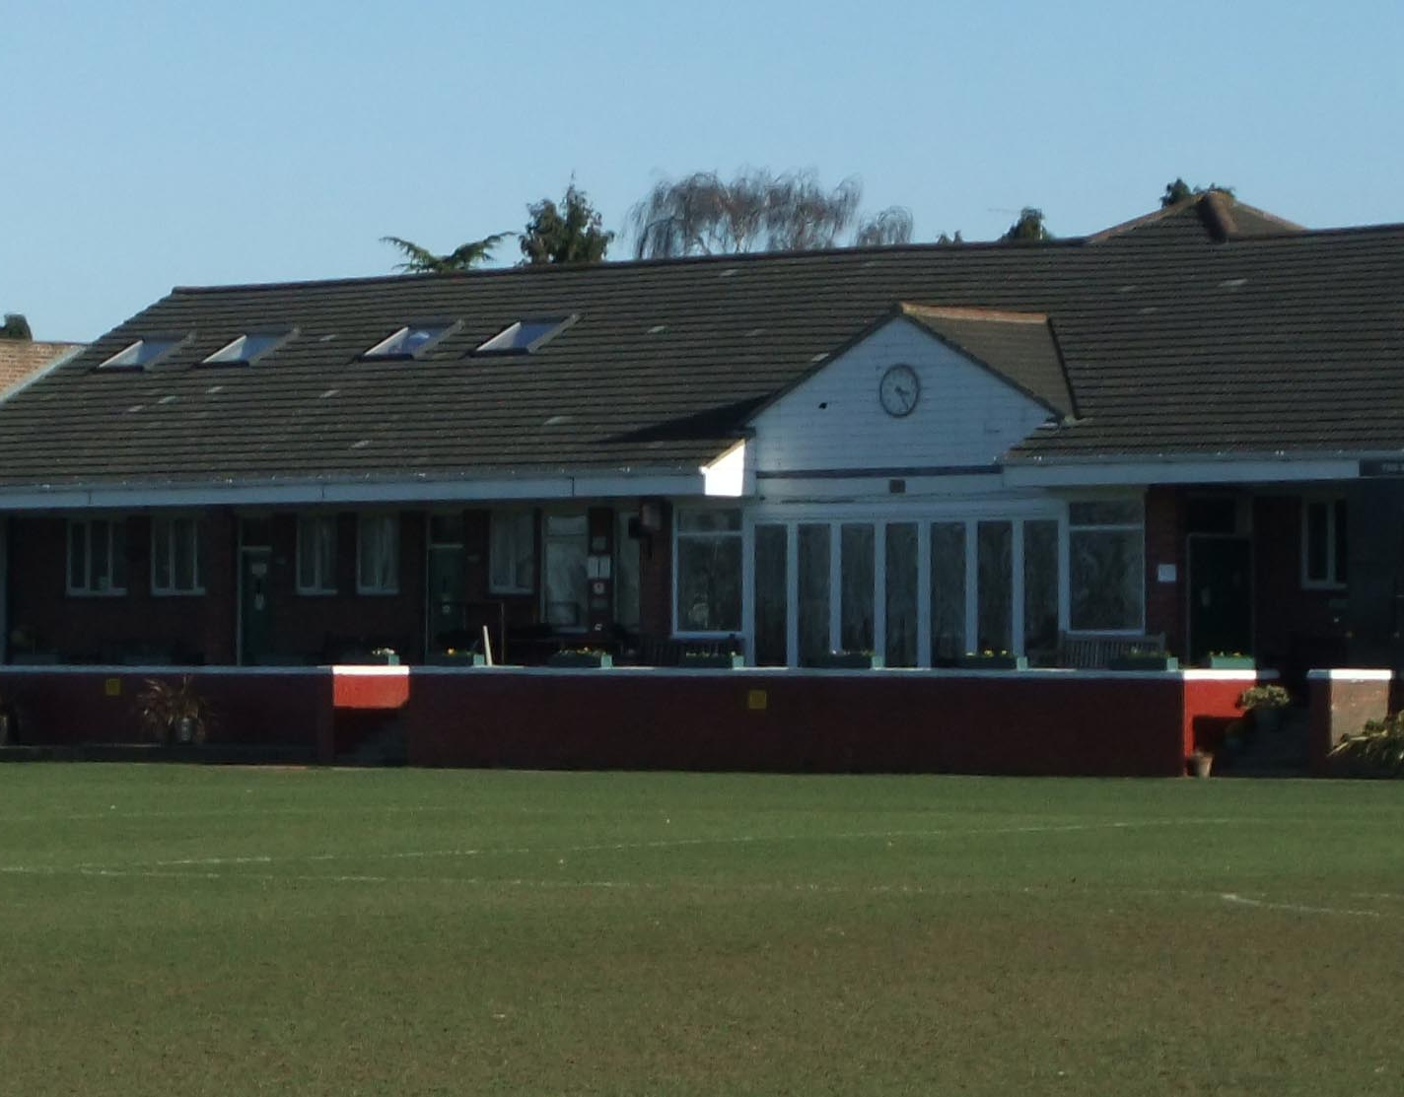
Old Wilsonians
Newsletter
November
2023
Full recap of the weekend’s events

Slide 2
In this newsletter?
Results from the weekend of Saturday 4th January 2025
Dates for the Diary
OWA Presidents 121 Years Anniversary Ball, Saturday 3rd May 2025.
OWFC Tour to Belgrade (May 29th to 1st June 2025)
Other Bits
Men Of The Hill
All Our yesterdays (25/ 50 years Ago)
Monday night Training @ Coloma School, Shirley, 8pm until 9.30 on their 3G pitch with a UEFA B Qualified Coach. Cost is £5
OWFC Code of Conduct and Annual Subs Update
Team of the Week
Fixtures for next weekend
OWFC Togger (Contact Roddy Trompiz, OWFCtogger@outlook.com)

Slide 3


Slide 4
Old boys Dave & Charlie Beer (2013, 2009), Josh Mackley, Ben Giles and Jude Boateng (2013) will be playing in a mental health awareness fundraiser between charity sides BHMT FC and Beder FC at Dorking Wanderers FC at 6pm on Saturday 14th December. BHMT support community-based mental health projects around the country, while Beder take a unique approach to softly raising awareness around mental health and suicide prevention through events like football matches. There will be a couple of ex-pros playing, a special guest from the BBC on mic and several mental health charities from the South of England speaking at half-time. Tickets are freeand Jamie Parkinson is managing the 2013 school side. here: https://emea01.safelinks.protection.outlook.com/?url=https%3A%2F%2Feventbrite.co.uk%2Fe%2Fbhmt-fc-vs-beder-fc-mental-elf-derby-fundraiser-tickets-993824033437&data=05%7C02%7C%7C2049f5a32d904de1d47008dd073d6452%7C84df9e7fe9f640afb435aaaaaaaaaaaa%7C1%7C0%7C638674682423534877%7CUnknown%7CTWFpbGZsb3d8eyJFbXB0eU1hcGkiOnRydWUsIlYiOiIwLjAuMDAwMCIsIlAiOiJXaW4zMiIsIkFOIjoiTWFpbCIsIldUIjoyfQ%3D%3D%7C0%7C%7C%7C&sdata=xZiZG0oSN5JRhzxujT6rwhh12aYMszxEdNGdjx6zeXU%3D&reserved=0 and you can donate here if you would like to contribute: https://emea01.safelinks.protection.outlook.com/?url=https%3A%2F%2Fwww.justgiving.com%2Fcampaign%2Fbhmt-xi-vs-beder-fc-football-fundraiser&data=05%7C02%7C%7C2049f5a32d904de1d47008dd073d6452%7C84df9e7fe9f640afb435aaaaaaaaaaaa%7C1%7C0%7C638674682423556146%7CUnknown%7CTWFpbGZsb3d8eyJFbXB0eU1hcGkiOnRydWUsIlYiOiIwLjAuMDAwMCIsIlAiOiJXaW4zMiIsIkFOIjoiTWFpbCIsIldUIjoyfQ%3D%3D%7C0%7C%7C%7C&sdata=eXjHWZ63WVb%2BR28JPgc3Z3GBbaTLZ%2BiFmxzSU2Bzx24%3D&reserved=0.

Slide 5
OWFC Business Code of Conduct / Annual Subs
A new season is upon us . With the influx of juniors and schoolboys , plus training and most team playing through the summer. Our hopes are high. We have expanded to 7 teams on Saturday & the Vets have joined the vets league on Sundays . Supervets will continue to play friendlies on Sundays.
We have raised annual subs for 21s & over in employment to £150 & under 21s in employment £75, both pay £10 weekly subs . If you are playing 4 or less games you will pay £20 match fees . junior members paying annual subs to the junior section. & schoolboys pay no annual subs but £5 weekly subs. Vets due to the number of games pay annual subs , Supervets £20 per game . Unemployed please chat to your skipper or Stu Dunk (treasurer or me (asst treasurer) and we will agree something that is workable for you as we want you to play . Annual subs are due on 30thSeptember 2024 . We are using pitchero & you should have an email to confirm your details, receive newsletters , about events also paying your annual subs or outstanding fines like yellow and red cards.

Slide 6
Why the rise in annual subs ? our rent to the association has gone up by £3,500 to £22,500 per annum . The reason is ground maintenance (looking after both hayes & hawesdown ) costs £60,000 per year , utilities has gone from £21,000 in 2021 to over £50,000 in 2024. So it is important you pay your annual subs on time as we look to break even. Its also important you support events not only so you meet players from other teams but also have some fun & hopefully we make a bit of money , which will hopefully keep your annual subs as low as possible
Also find a code of conduct we expect all our member to follow. Please read them as this is the minimum we expect as a club.
Heres to a great season , good luck & enjoy
Alex Forbes
OWFC Assistant treasurer

Slide 7
Old Wilsonians Football Club
Code of Conduct
As a representative of the Old Wilsonians Football Club, I agree that;
On and off the pitch, I will:
• Always play the game fairly and in the right spirit.
• Be aware of the impact of bad language; keep spectators and members of the public - including
children - in mind.
• Never verbally abuse a match official, player or spectator based their appearance, race, religion,
gender or sexuality. Doing so could lead to dismissal from the field, suspension and possible police action.
• Never physically assault a match official, player or spectator. Doing so could lead to dismissal from the field, suspension and possible police action.
• Help to create a safe and inclusive environment both on and off the pitch.
• Report all allegations of abuse or poor practice to the Club Welfare Officer.
• Not to abuse, neglect, harm or discriminate against anyone; or act in a way that may be interpreted as such.
• Adhere to the club’s safeguarding policy, rules and regulations.
• Attend the match with correct kit, this includes black shorts and gold socks.
• Arrive on time. If for any reason I may be late, I will inform my captain as soon as possible.
• Respect the decisions made by my captain.
• Not drop out from the game at short notice. This is unfair to other players who may have been left out, so that I could play. If I have a valid reason, I will inform my captain. Failure to contact my captain will result in being reported to the disciplinary committee.

Slide 8
Old Wilsonians Football Club
Code of Conduct continued
Selection, finances and expected conduct.
• I understand, if I have made myself available to play, I will be expected to represent any team within the Old Wilsonians football club, as per rule 11 of the OWFC rules.
• I will sign up to the FA Matchday app.
• I will pay my annual and weekly subs on time. If I am unable to do this, I will inform the club treasurer who may be able to assist.
• I will conduct myself in such a manner as not to bring the Old Wilsonians football club into disrepute.
• I will not be involved with/under the influence of any drugs or illegal substances whilst representing the football club, in line with the OWFC drugs policy.
• When playing at home, I will help when required to offer hospitality to the visiting teams and complete requested duties.
• I understand the expectation that I support the club with fundraising events and activities.
• I understand that I need to provide the club with any personal data required for registration and/or safeguarding purposes.
• I will refrain from any criminal activity. I will represent the club with integrity and honesty.
.

Slide 9
Old Wilsonians Football Club
Code of Conduct continued
I understand:
If I do not follow the Code, I may expect to:
• Be cautioned, sin binned or sent off by the match officials, depending on the nature of the offence.
• Be asked to apologise to whoever I have offended or abused.
• Be disciplined by my club via the disciplinary committee, including being substituted, dropped, given a formal warning,
suspended from training or matches or a permanent suspension from the club. This will depend on the nature of the offence.
• Be disciplined by the County Football Association, including being fined or suspended for a number of matches depending on the nature of the offence.
• Be handed a permanent exclusion by the FA or County Football Association, if the offence is deemed serious enough.
Declaration;
I agree to abide by the conditions above and follow any guidance or policy as set out by Old Wilsonians football club, The AFA (County FA) or the Football Association.
Name:
Date of Birth:
E-mail address:
Phone number:
Address:

Slide 10

Men Of The Hill
Its good to talk. Its ok, not to be ok.
Several Old Boys and Club members have set up a Facebook group during these difficult times.
Talking about how we feel is something we all find hard to do whether you are a Man or a Woman.
About
This group has been set up to help anyone connected to the Wilsonian Sports club, whether they be friends of friends or family members.
Private
Only members can see who's in the group and what they post.
To access the group search on Facebook or Click Here.

Slide 11
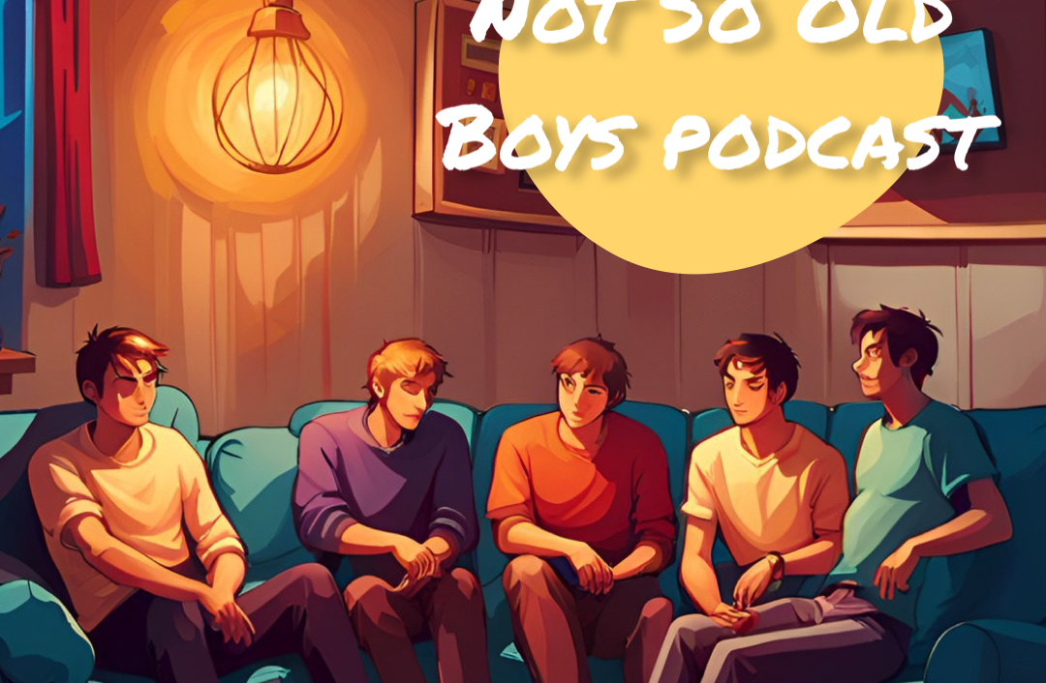
Not So Old Boys
Kicking taboo out of the game
After meeting through football and becoming a close knit group of friends.
They decided to launch a podcast to discuss taboo topics and just let the world know what it's like to play on Saturday football.
Follow the adventures of the Old Wilsonians Football Club through this Podcast and on Instagram.
Available on popular streaming platforms

Slide 12
Results
 | Vs | Score | Scorers
OWFC 1Xi | Old Parkonians | Postponed
OWFC 2Xi | Carshalton | 3-2 | Catton 2, Qaushie
OWFC 3Xi | South Bank | Postponed
OWFC 4Xi | Merton | Postponed
OWFC 5Xi | Merton | Postponed
OWFC 6Xi | Polytechnic | Postponed
OWFC 7Xi | City of London | Postponed
OWFC Vets | Morden Expats | Postponed
OWFC SuperVets / Vets | No Game
A round up of all this week's results and scorers for the weekend of 4th January 2025.

Slide 13
Match Report: 4/1/2025. Carshalton 1XI 2-3 Old Wilsonian 2XI
OWs returned to league action after a lengthy break hoping to lose some excess weight gained at Christmas and to win away at Carshalton. OWs started the game strongly with some expansive, attacking football before Carshalton delivered a sucker punch, seeing the hosts take an early lead. Despite this, the boys maintained a positive approach, building from the back and trying to unleash the wide men, particularly with ROBINSON enjoying success and even displaying a touch as if he’d been raised in the streets of Rio.
Old Wilsonians managed to craft some half chances, mainly some long ranged shots from CAMPBELL & CORMACK, with one of the latter’s landing back at Hayes Hill. The game continued with the visitors dominating, but unfortunately a second ball fell to a Carshalton player who volleyed it in to make it two. The half hour mark saw the introduction of all action CATTON who provided a spark from the midfield for the away side, who pierced a ball through to their backline to QUASHIE who calmly slotted it round the keeper. 2-1 to the home side at half time.
The second half started in a similar fashion with OWs carrying the momentum with some more attacking play yet failing to carve out another goal. Our fortune soon turned after CATTON displayed some dark arts by very blatantly using his hand to flick the ball round an opposition defender, but managing to hide it from the referee. SHELTON tried to imitate this by punching the ball at the back post from an inswinging corner, but he did not enjoy the same success as Maradona, or our equivalent, CATTON.
OWs found an equaliser, started off by a heroic block from FITZGERALD, which started a counter attack, with CAMPBELL striking the bar and CATTON eventually did manage to convert from a header moments after. The away side kept pushing for a winner, whilst staying defensively solid which left the last dozen minutes of the game quite stretched. OWs finally reaped the rewards for their impressive football after a SHELTON ‘through ball’ saw that man CATTON in behind once again, who made no mistake about the finish, leaving the score at 3-2.
The away side continued to keep the ball to ease the opposition’s efforts to get back in the game, before the referee blew the final whistle. 3 points for OWs as they look to climb the table, and celebrations led into the clubhouse after with pizza and perhaps the worst pints of Guinness ever produced.

Slide 14
Fixtures
 | Vs | Competition | Location
OWFC 1Xi | Nottsborough | SAL | Away
OWFC 2Xi | Actonians | SAL | Away
OWFC 3Xi | South Bank | SAL | Home
OWFC 4Xi | Actonians | SAL | Home
OWFC 5Xi | 6s | SAL | Away
OWFC 6Xi | 5s | SAL | Away
OWFC 7Xi | No Game | SAL | Home
OWFC Vets | Parklife | SAL | Home
OWFC SuperVets | Old Sutts - tba | F | Away
A look at all the upcoming fixtures for the weekend of 11th January 2025 throughout the club (Week 16)

Slide 15
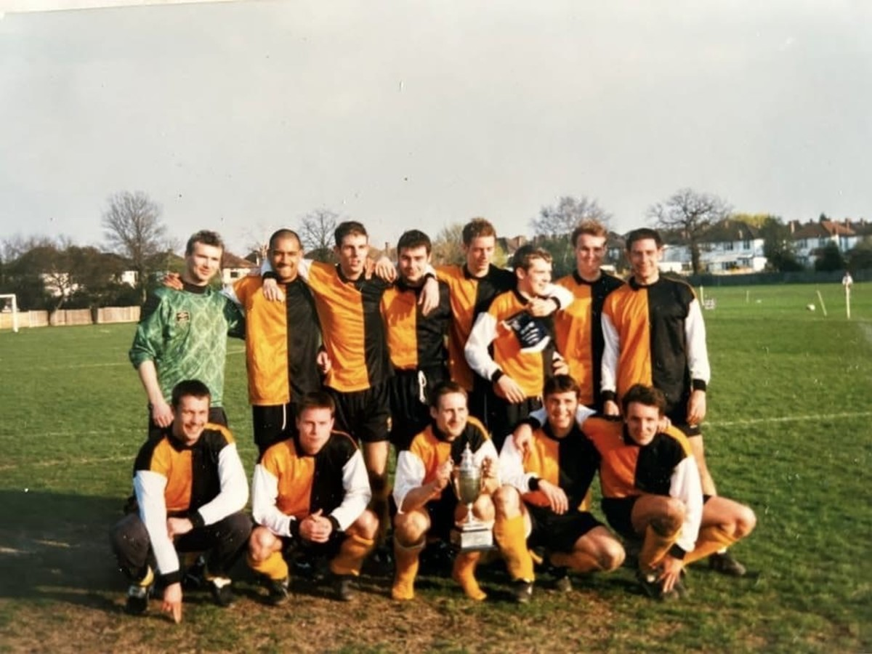
ALL OUR YESTERDAYS - 25 YEARS AGO
Classified Resuts , December 18th 1999
2nd Xl | 1 | Old Hamptonians | 2 | Karamath
Old Tenisonians | 0 | 4th Xl | 8 | Daniels 4, Kirkham 2, Willis, Pilgrim.M
5th Xl | 2 | East Barnet Old Grammarians | 3 | Gower, Chillman
7th Xl | 6 | Old Edmontonians | 0 | Evans 3, du Casse 2. OG
8th Xl | 3 | Gullible’s Travellers | 0 | Shale 2, Cocks
Palace | 0 | Fulham | 0

Slide 16
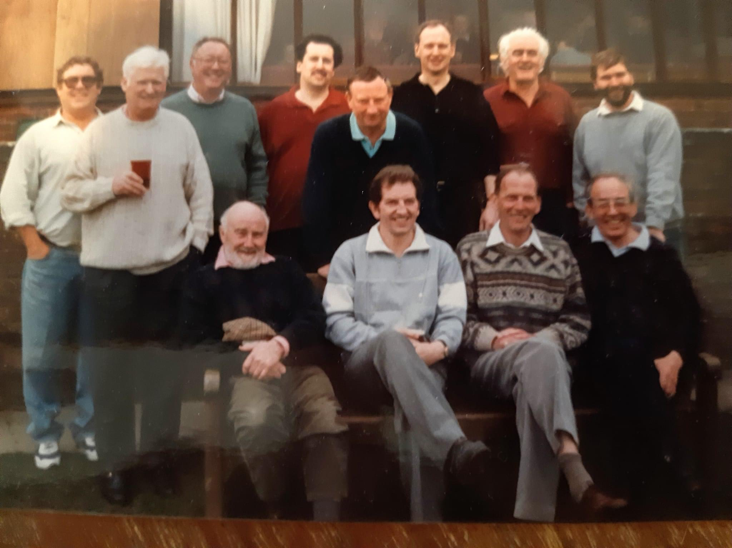
ALL OUR YESTERDAYS - 50 YEARS AGO
Classified Results
Classified Results, December 28th 1974
General Accident Fire Life Assurance Company | 3 | 2nd Xl | 4 | Simner 2, Montgomery, Maunder
3rd Xl | 4 | Southgate County | 1 | Kendrick.M, Vince, Powell, Poynter
Old Finchlians | 0 | 5th Xl | 9 | Cave 3, Cowell.J 2, Portman, Miles, Balm, OG
6th Xl | 1 | Fulham Compton | 2 | Wellman

Slide 17
WIND AND RAIN INFLUENCES SEVEN GOAL THRIILER Gaflac 1st Xl 3 2nd Xl 4
An extremely windy day saw the 2nd Xl, full of Christmas food and spirit – and beer – venture on to a rain sodden pitch against General Accident Fire Life Assurance Company 1st Xl (GAFLAC), who play in the 2nd Division of the Insurance League. Christmas hangovers and cobwebs were soon blown away during the kick-about before the game, but it was obvious that conditions were not going to allow good football to be played.
The wind was behind us in the first half, and we were using high and long through balls to trouble our opponent’s defence, but we could not capitalise on this as the powerful wind and speed of the bal; skimming off the pitch increased its momentum and saw it going beyond the goal-line for numerous goal-kicks, although Colin Hand, realising the strength of the wind, did hit a tremendous 45 yard shot that the opposing goal-keeper just scrambled over the bar for a corner.
Eventually our pressure told and another long clearance from Martin Taylor cleared the heads of Tony Maunder and GAFLAC’S centre-half for LES SIMNER to streak in from the wing and collect the ball on the edge of the area, move a few paces and place a well-taken shot into the bottom corner of the net. Half-time came with no further goals, but some near misses from Martin Taylor, who seemed determined to emulate Pat Jennings by scoring from a goal-keeper’s clearance.
The second half saw the roles of the teams reversed, and quicker adaptation by GAFLAC saw them making their intentions clear from the start, with good defensive clearances and first time powerful shooting, causing Martin Taylor to make some very good saves.
In one of our breakaways a good through ball from Ray Jenkins enabled LEIGH MONTGOMERY to score a similar goal to our first to put is two up. Our lead was soon cut, however, by a very good move and shot from our hosts, only for us to add a third two minutes later when Tony Maunder put ‘Monty’ away down the left and his cross was put home by LES SIMNER after three bites of the cherry whilst sliding and wriggling on his rear like an eel.
But GAFLAC hit back straight away by scoring from yet another long clearance, only to have their morale sapped again by our fourth goal, scored by TONY MAUNDER and, then, five minutes before time, GAFLAC finished the scoring with a very hard shot from just outside the penalty area.
A fair result, with the 2nds beating not only the opposition but the weather and conditions as well; an excellent game from Leigh Montgomery, good games from Les Simner and Martin Taylor, with Ray Jenkins and George Carrington adding the pieces to their games that have been missing for a few weeks. Alan Carpenter

Slide 18
THINGS ARE LOOKING GOOD FOR THE 6th Xl Old Grammarains 6th Xl 1 5th Xl 9
A very convincing win by the 5th Xl against a Grammarian 6th Xl who have yet to gain a point this season. We started well and were a goal up within the first five minutes thanks to JOHN COWELL. A second goal came shortly afterwards from KEITH MILES, who was rewarded for his aggressive play, and MICKEY CAVE made it 3-0, but that was the end of the scoring in the first half.
The second half brought six goals from Mesers CAVE(2), BALM, COWELL, PORTMAN and an own goal, forced by good pressure from the attack. Outstanding performances came from Jim Marsh, Alan Tyson – who now plays at right-back – and Mickey Cave, and a good win for the probable/hopeful winners of the league. John Cowell
Marsh Tyson Hands Houghton Portman Miles Jones Balm Cave Cowell.J Gibbons
Here is the News
The Football Club’s New Year’s Honours list was published this week and, as usual, it makes very interesting reading. Amongst the awards were: a new pair of gloves for Rod Hall, the League secretary’s ‘phone number for Terry Adams, a new hair-style for Geoff Robinson and a box for Chris Cowell to stand on.
Nick Carter becomes a peer and Les Simner is also elevated, but is still shorter than anyone else. Martin Taylor gets the Des O’Connor song-book, with a foreword by Eric Morecambe, Alan Carpenter a new hammer and George Carrington a new coat.
Bob Harper gets an alarm clock, Ian Forbes a hair rinse and ‘Mac’ a new lease of life, although he is trying to sell it to Les Wilks or John Brittain.
Leading scorers
12 Cowell.J 11 - Cave 10 – Montgomery, Simner 9 - (Jim) Matthews 8 - Davis.A, Reaseley

Slide 19


BIG IMAGE
Old Wilsonians Club Shop

Slide 20










A massive thank you to all your support with our grass roots football
OWFC Sponsors
Cladish Sports Wallington

Slide 21
Club Contacts
 | Name | Email Address
OWFC Xi | Josh Eves Sam Wright | evesjoshua@gmail.com sam_wright_29@hotmail.co.uk
OWFC 2Xi | Jack Shelton Danny Mansfield | jackshelton98@outlook.com dtmansfield15@gmail.cpm
OWFC 3Xi | Michael Hoffman Chesney Jennings | m.hoffman95@hotmail.co.uk chezbjennings@gmail.com
OWFC 4Xi | Toby Shelton | tobyshelton3@gmail.com
OWFC 5Xi | Chris Dyki | chris@inhousephotography.co.uk
OWFC 6Xi | Joe Kajdi Andrew Callam | joseph.edward@hotmail.com andrewcallam@hotmail.co.uk
OWFC 7Xi | Alex Forbes | alexforbes46@hotmail.co.uk
Vets Super Vets | Jamie Parkinson Doug Forbes | jamieparkinson@hotmail.co.uk doug.forbes@outlook.com
Selection Sec | Cejay Watson
Roll of Honour
RIP Life President: Mike Harris
Treasurer: President:
Stu Dunk
Chesney Jennings
Chairman: Dan Harris
Hon. Secretary: Jamie Parkinson
Club Captain: Sam James
Newsletter Contribution - All contributions to the newsletter should reach Mark Pope by 6:00 pm on a Monday evening – the earlier the better. Please send any articles/match reports/images to markypope@hotmail.com or via Whatsapp on 07788 780486

Slide 22
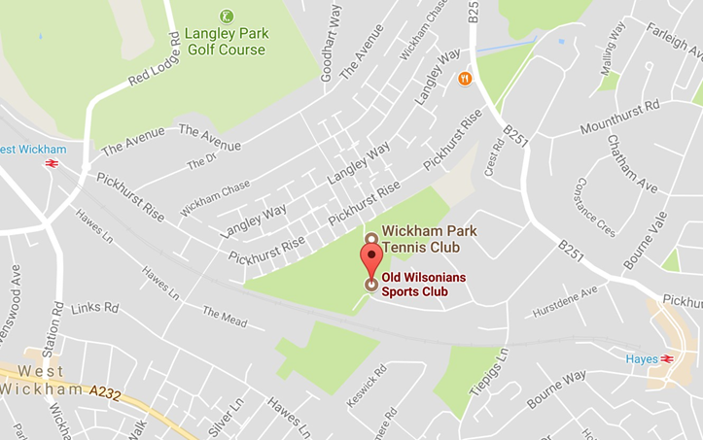
Where to find us?
Where to find us
Old Wilsonian Hayes Hill
Hayes
Kent, BR2 7HT
Tel: 020 8462 2600
Closest Rail Station – Hayes (Kent) 14 min walk
Social Media
Website: www.oldwilsonians.com
Twitter: @oldwilsonians Facebook: OWFC Facebook Group (Members Only)
Newsletter Contribution - All contributions to the newsletter should reach Mark Pope by 6:00 pm on a Monday evening – the earlier the better. Please send any articles/match reports/images to markypope@hotmail.com or via Whatsapp on 07788 780486

